Slide 1
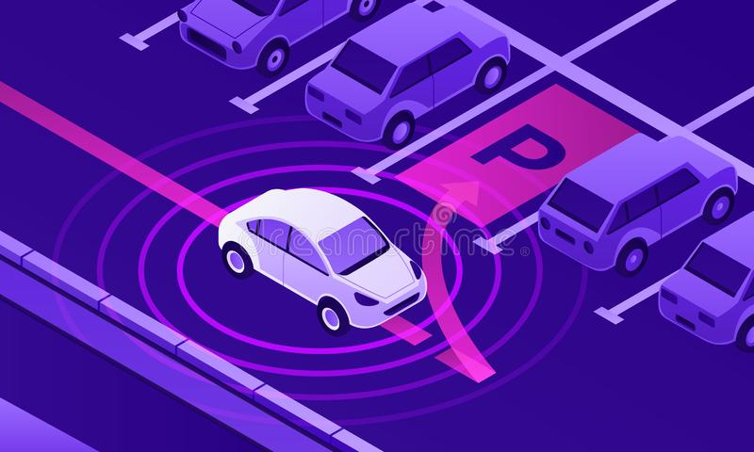
Car Maze Solver Project
Pioneer Team
Undersupervision of Engineer: Samer Elsayed

Slide 2

Contents
Motivation
Parts of Car
Hardware Connections
Software Connections
How It Works
Conclusion
Notes:
Photo by powerpoint stock

Slide 3
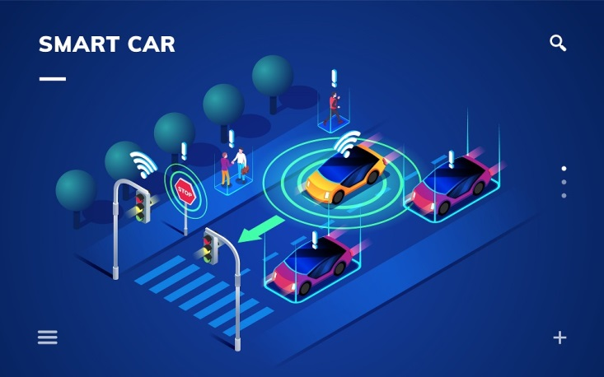

Motivation
Robots are expected to be intelligent and one of the way to test this
intelligence is to cheak whether the can solve a maze or not, Maze solving
is an important field of robotics and is based on one of the most important
areas of robotics which is decision making algorithm.
Notes:
<a href='https://www.freepik.com/photos/corporate-building'>Corporate building photo created by fanjianhua - www.freepik.com</a>

Slide 4

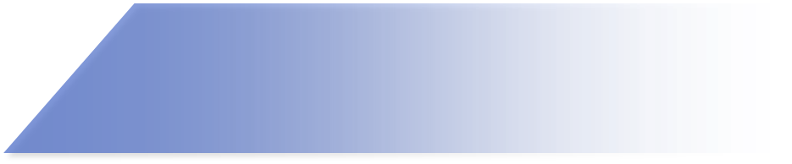
Parts of Car
Arduino Uno board
L298N Dual H Bridge Motor Driver
3 IR Sensor
Two Gear DC Motor
Chassis and Castel wheel
12 Volt Battery
Notes:
Photo by powerpoint stock

Slide 5
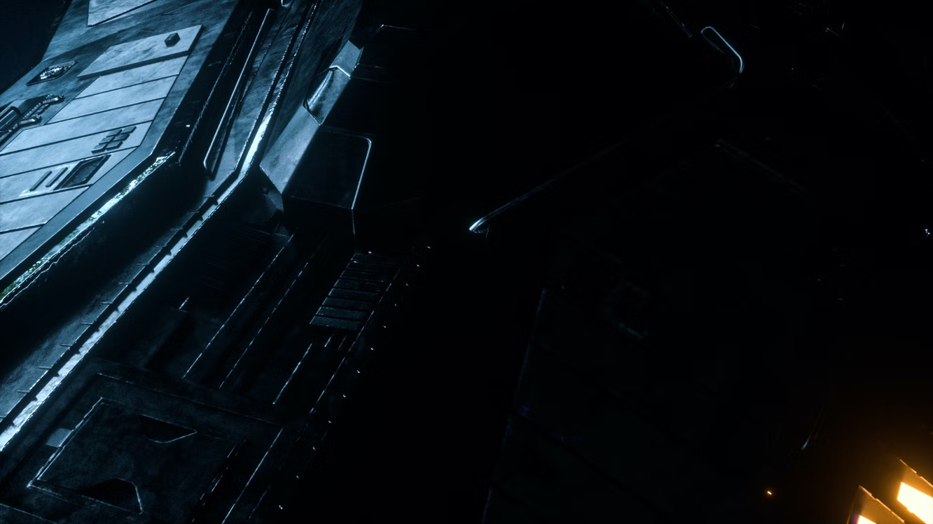
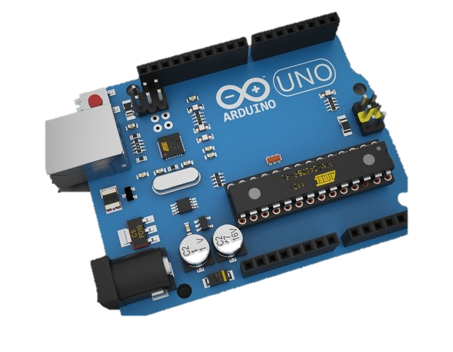
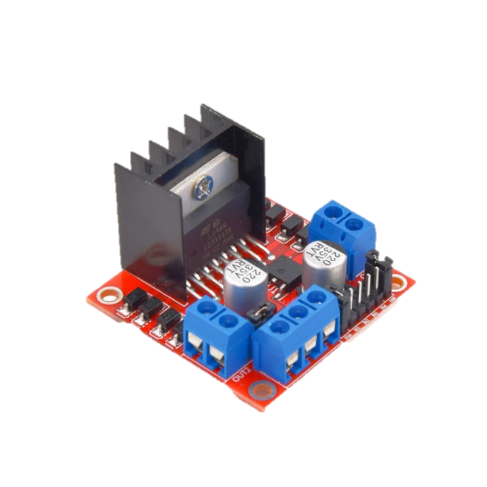
Arduino Uno Board
Arduino Uno has 14 digital input/output pins (of which 6 can be used as PWM outputs), 6 analog. It contains everything needed to support the microcontroller.
L298N H Bridge Motor Driver
It can control both the speed and rotation direction of two DC motors.
Notes:
https://unsplash.com/photos/qE_5MKhudo0

Slide 6
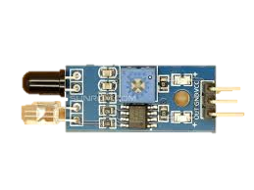
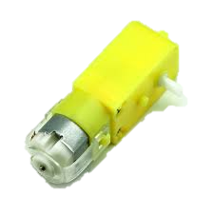
3xIR Sensors
To detect 1 (black line ) or zero (white).
Two Gear DC Motor
It can control both the speed and rotation direction of two DC motors.
Notes:
https://unsplash.com/photos/qE_5MKhudo0

Slide 7
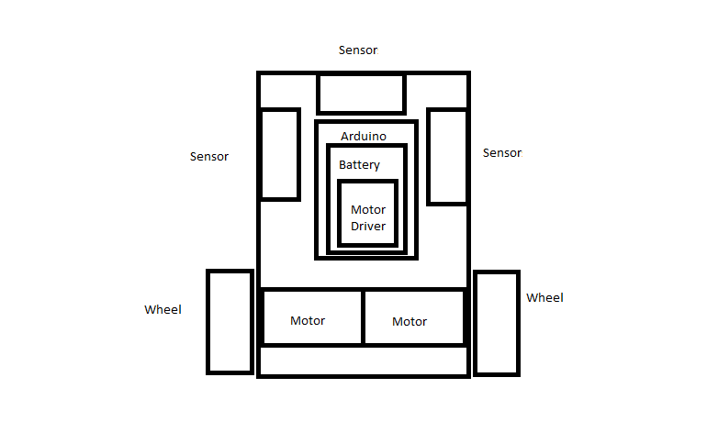
Body Design
Notes:
https://unsplash.com/photos/QfLm-2AiJ_M

Slide 8
Hardware Connections
Notes:
https://unsplash.com/photos/QfLm-2AiJ_M

Slide 9
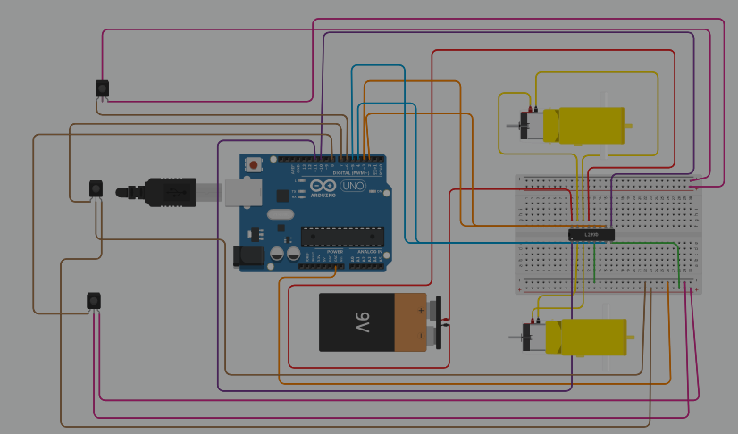

Notes:
<a href='https://www.freepik.com/photos/city-lights'>City lights photo created by rawpixel.com - www.freepik.com</a>

Slide 10
Software Connections
Notes:
https://unsplash.com/photos/QfLm-2AiJ_M

Slide 11


How it works & Bonus
Notes:
<a href='https://www.freepik.com/vectors/connected-dots'>Connected dots vector created by liuzishan - www.freepik.com</a>
Photo by Tom Parkes on Unsplash

Slide 12

THANK YOU
Notes:
Photo by Brian McGowan on Unsplash

